Slide 1
Sleep Pattern Analysis
Use Case 1
Transformed the given dataset into following types
Days
0-weekend
1-weekday
Individual days of the week
2) Categories of sleep time duration
very short < 1 hour
short 1 to 2 hours
medium 2 to 4 hours
long 4 to 7
very long >7 hours
2) Categories of time of the day based on starting of sleep
midnight 00 to 04
early morning 04 to 08
morning 8 to 12
afternoon 12 to 16
evening 16 to 21
night 21 to 00

Slide 2
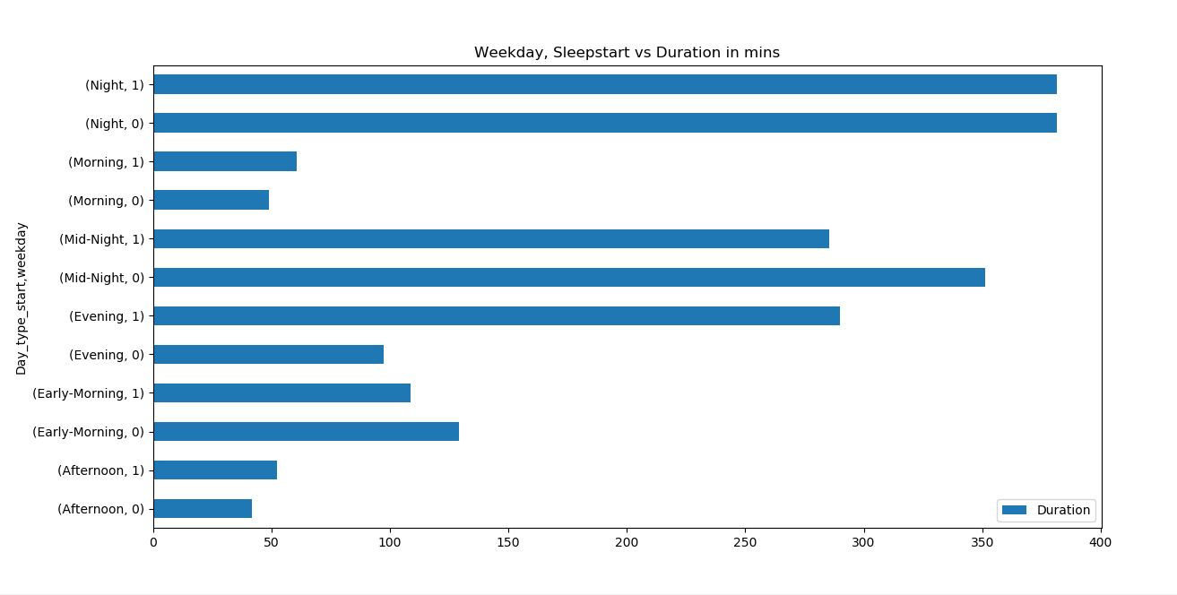
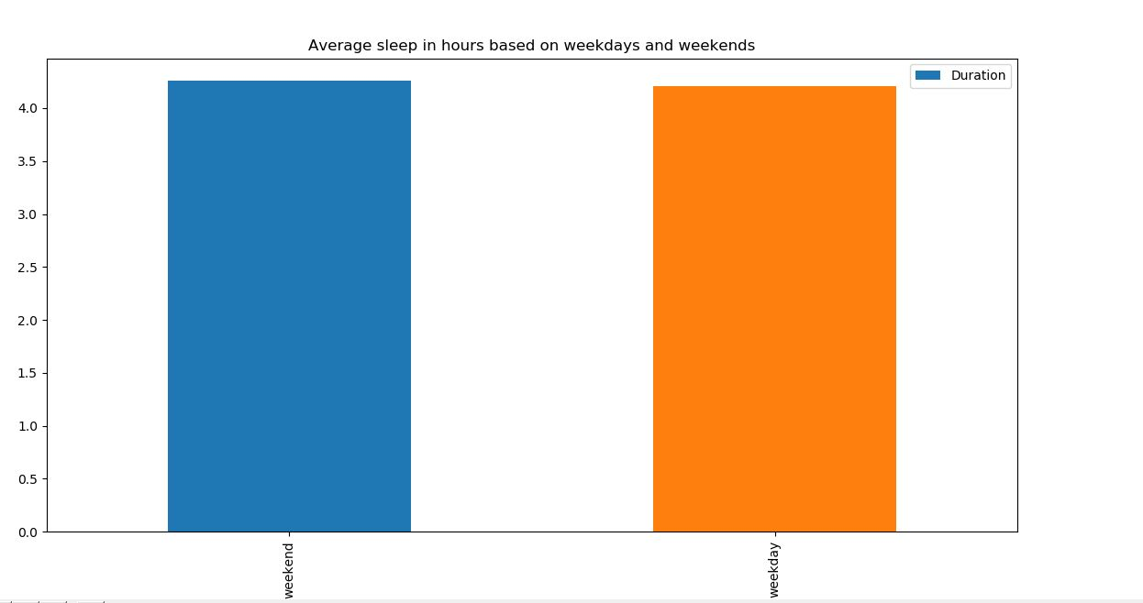
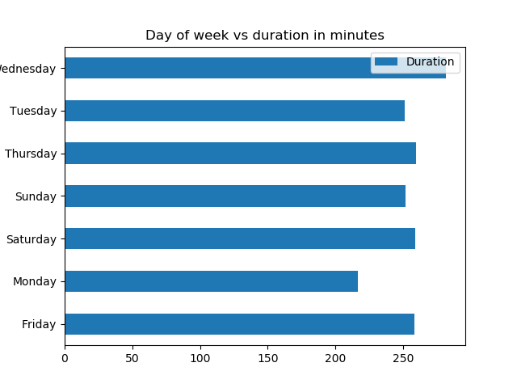
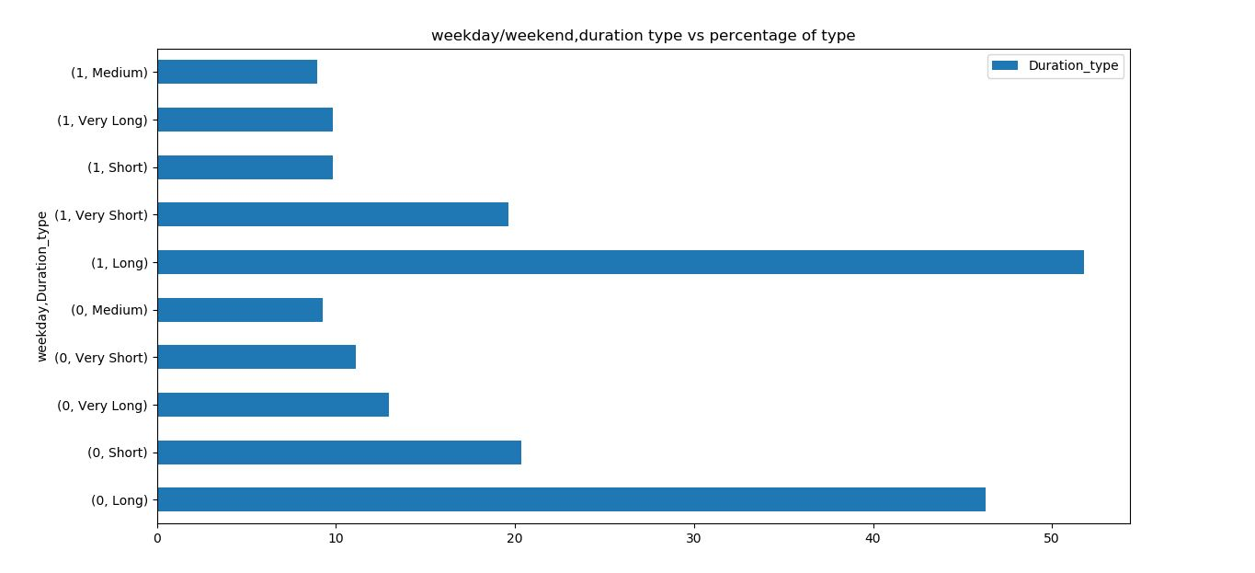
Analysis on sleep duration

Slide 3
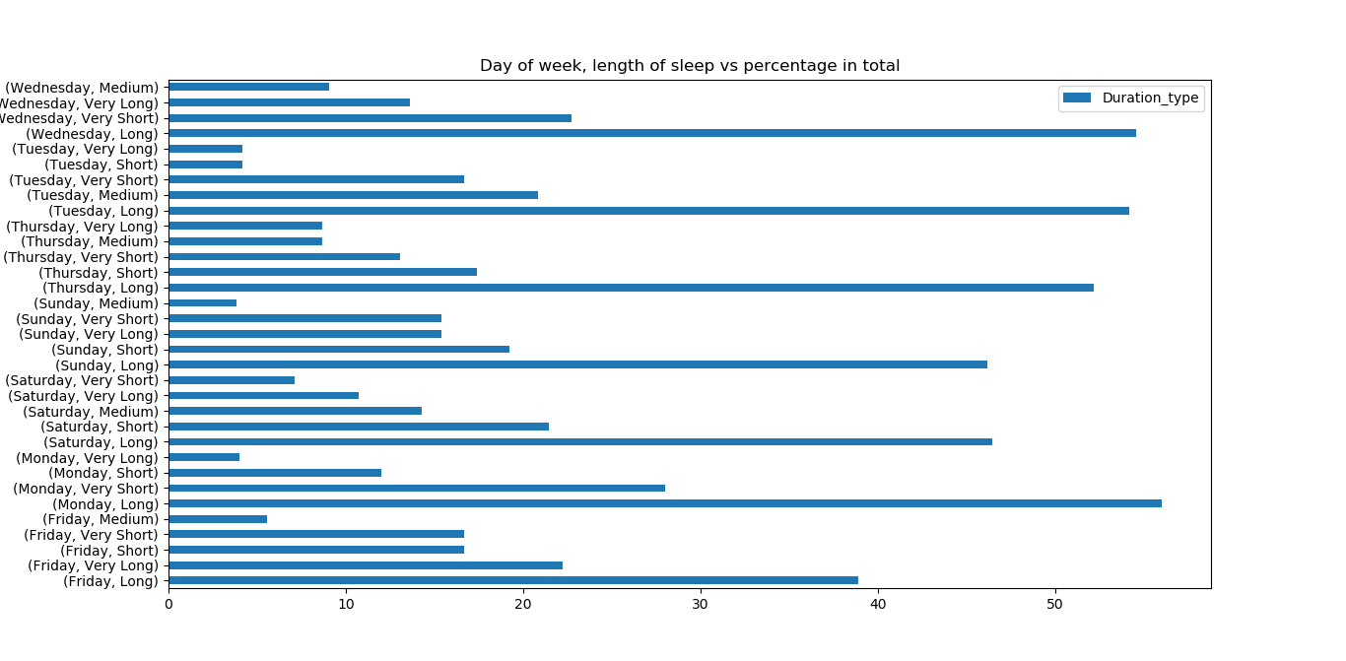
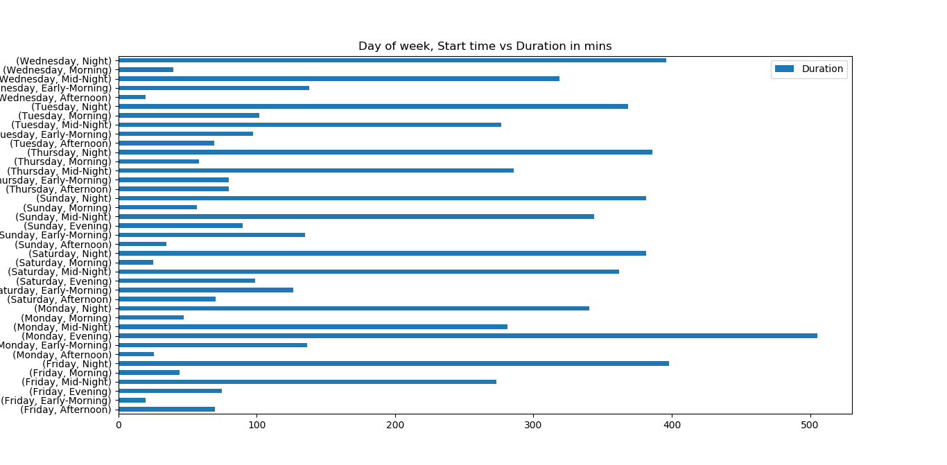
Cont…

Slide 4
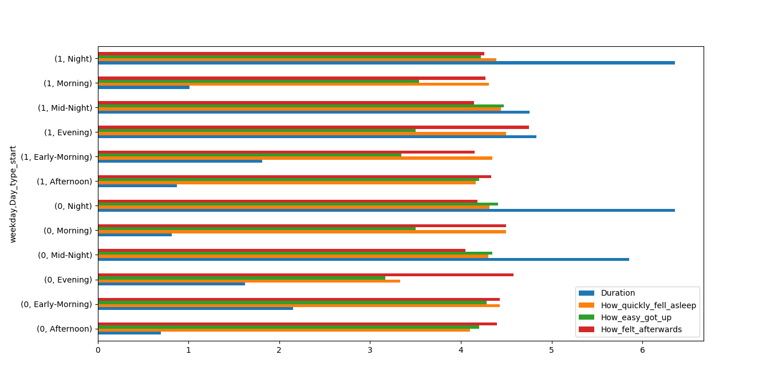
Overall Analysis – Weekday/Weekend, Time vs all attributes

Slide 5
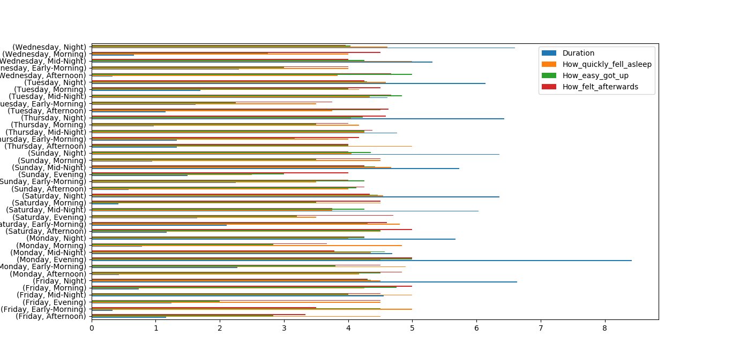
Overall days analysis

